Slide 1
Statistical Experiments and Significance Testing
Unit 02 Lecture 05
Dr Muhammad Ismail Mangrio

Slide 2
Contents
A/B Testing
Hypothesis Tests
  The Null Hypothesis & Alternative Hypothesis
Resampling
  Permutation Test , Example: Web Stickiness
  Exhaustive and Bootstrap Permutation Tests
  Permutation Tests: The Bottom Line for Data Science
Statistical Significance and p-Values
  p-Value, Alpha , Type 1 and Type 2 Errors
  Data Science and p-Values
t-Tests
Multiple Testing
Degrees of Freedom
ANOVA
  F-Statistic
  Two-Way ANOVA
Chi-Square Test
  Chi-Square Test: A Resampling Approach
  Chi-Square Test: Statistical Theory
  Fisher’s Exact Test
  Relevance for Data Science
Multi-Arm Bandit Algorithm
Power and Sample Size

Slide 3
A/B Testing
An A/B test is an experiment with two groups (i.e., Control and Experimental) to establish which of two treatments/products/procedures, or the like is superior.
Often one of the two treatments is the standard existing treatment, or no treatment.
If a standard (or no) treatment is used, it is called the control.
  A typical hypothesis is that a new treatment is better than the control.

Slide 4
A/B Testing
A/B testing (also called split testing) is a controlled experiment used to compare two versions of something to determine which one performs better.
  “A”=current version (control)
  “B” = new version (treatment/variant/experiment)
It’s widely used in:
  Website optimization (click-through rates, conversions)
  Marketing campaigns (email subject lines, ad banners)
  Product design (UI/UX changes)

Slide 5
A/B Testing (Additional reading)
In a research study, there is usually an experimental group and a comparison or a control group.
Those who are in the experimental group will get whatever is being researched in the study.
Those in the control group will usually get standard treatment or a placebo that might look that same but not intended to have the same effects as experimental treatment or they might get nothing as at all.
A control group is needed because people will change naturally a bit from one day to another even without being in the study. Some day people might feel better another day might be a bit worst.
Even blood test results can be different at different times of day depending on diet, stress, hormones and some times mood.

Slide 6
A/B Testing
Some examples of A/B testing include:
  Testing two soil treatments to determine which produces better seed germination
  Testing two therapies to determine which suppresses cancer more effectively
  Testing two prices to determine which yields more net profit
  Testing two web headlines to determine which produces more clicks
  Testing two web ads to determine which generates more conversions

Slide 7
A/B Testing
Two groups in A/B test,
  one is control group, the other is
  Experimental group
A proper A/B test has subjects (like Patient/cat/Plant/people) that can be assigned to one treatment (Medicine/Fertilizer)/Experimental group.
The subjects need to be used/exposed to experimental group.
Ideally, subjects are assigned randomly to treatments.
  To have the effect of the different treatments
  To get unbiased/natural results
Notes:
https://www.optimizely.com/optimization-glossary/ab-testing/

Slide 8
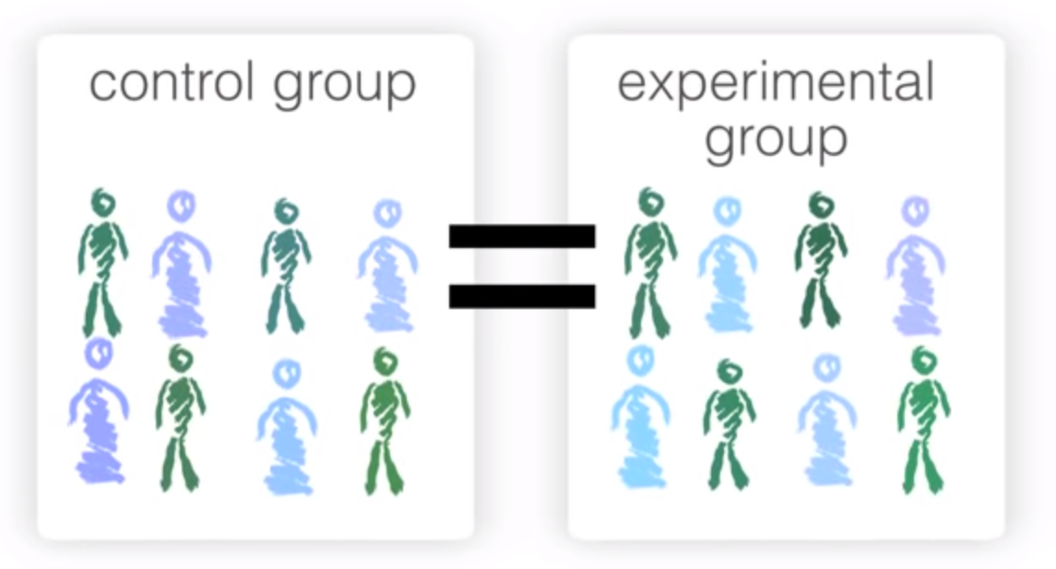
A/B Testing
Why Have a Control Group?
  Why not skip the control group and just run an experiment applying the treatment of interest to only one group, and compare the outcome to prior experience?
  Without a control group, there is no assurance that “all other things are equal” and that any difference is really due to the treatment (or to chance).
  When you have a control group, it is subject to the same conditions (except for the treatment of interest) as the treatment group. If you simply make a comparison to “baseline” or
  prior experience, other factors, besides the treatment, might differ.

Slide 9
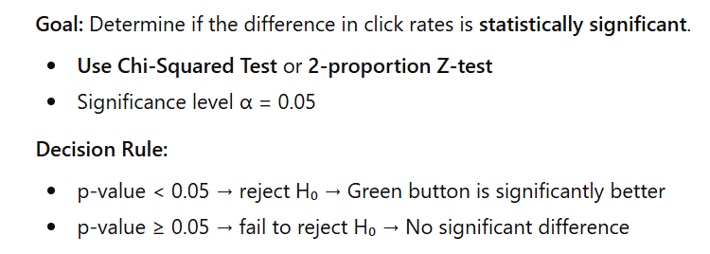
A/B Testing
Class Activity: A/B Testing – Website Button Clicks
A company wants to increase clicks on a website button.
Current button = Blue (A)
New button = Green (B)
100 users see each button. Click results:
Group | Clicked | Did Not Click | Total
A (Blue) | 20 | 80 | 100
B (Green) | 35 | 65 | 100

Slide 10
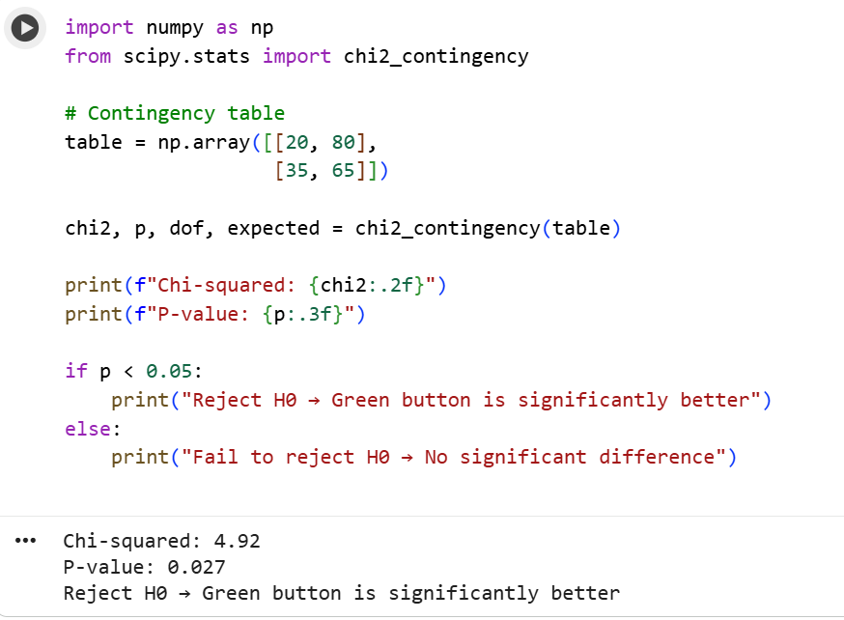
A/B Testing
Class Activity: A/B Testing – Website Button Clicks

Slide 11
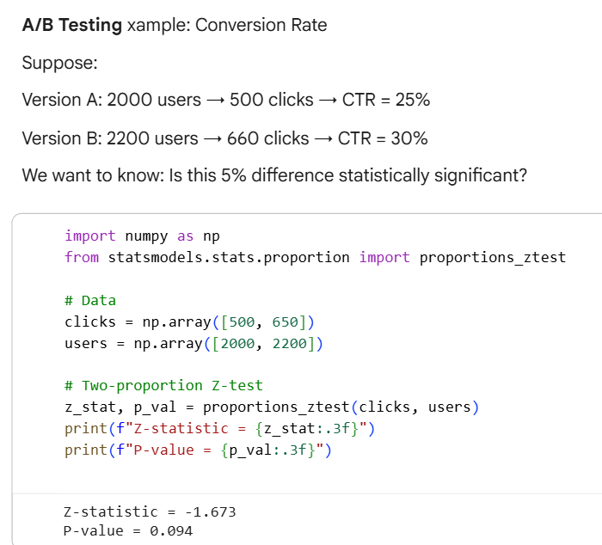
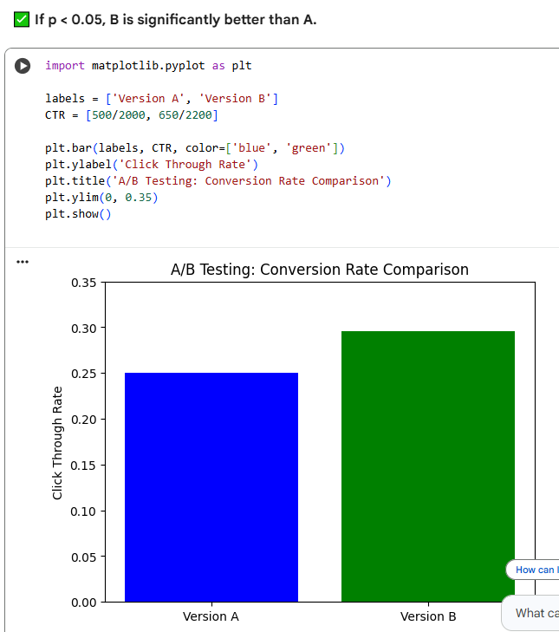
A/B Testing

Slide 12
Hypothesis Tests
Hypothesis: a promise or claim that we want to test.
  Like effect of a medicine on a experimental subject is significantly enough compared to the control subject (i.e., subject without medicine).
Hypothesis tests, also called significance tests, are ubiquitous in the traditional statistical analysis of published research.
A hypothesis test is a formal procedure to check if a hypothesis is true or not
Their purpose is to help you learn whether random chance might be responsible for an observed effect.
In a properly designed A/B test, you collect data on treatments A and B in such a way that any observed difference between A and B must be due to either:
  Random chance in assignment of subjects (reject)
  A true difference between A and B (Accept)

Slide 13
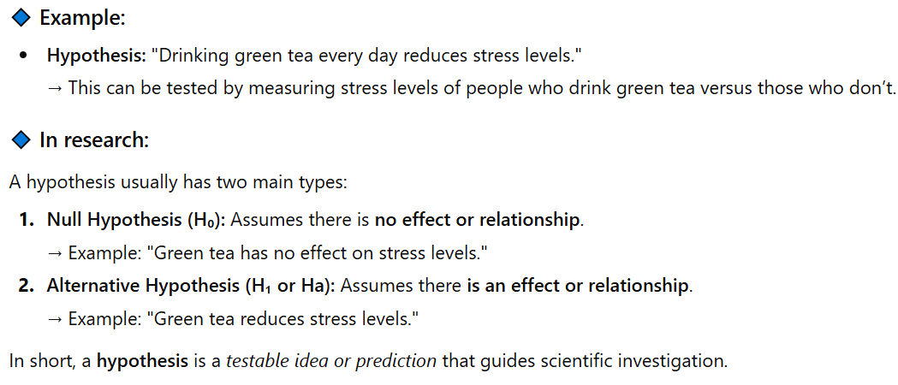
Hypothesis Tests
A hypothesis is an educated guess that tries to answer a question or explain something that you can test scientifically.

Slide 14
Hypothesis Tests
Two types of Hypothesis
The null hypothesis (H₀) and the alternative hypothesis (H_{α}) are the claims.
The two claims needs to be mutually exclusive, meaning only one of them can be true.
  Null hypothesis
    Also known as zero hypothesis (Why?, difference in both groups is zero)
    It is a baseline assumption that the treatments are equal and any difference in the groups is due to a random chance.
    Represented by H₀
    Currently accepted value for a parameter or established fact
  Alternative Hypothesis or Research Hypothesis
    Involves the claim to be tested
    Represented by H_{a}
Let us understand by an examples

Slide 15
Hypothesis Tests
Example: It is believed that a candy machine makes chocolate bars that are on average 5 g. A worker claims that the machine after maintenance no longer makes average 5g bars.
  H₀ = 5g
  H_{a} ≠ 5g
  H₀ and H_{a} are mathematically opposites
  We assume H₀ is correct until H_{a} is proved
Possible outcomes of this test
  Reject Null hypothesis OR
  Fail to reject Null hypothesis
In real life It is very hard to prove something is true/correct.
Thus hard to prove H_{a}≠5g is correct but
It is easier to reject H₀=5g or fail to reject.
Now how do we determine/test the H_{0.}
We need Test Statistic/metric, to calculate from sample data use to decide (Reject to Fail to reject H₀).

Slide 16
Hypothesis Tests
Back to example
  Sample 50 bars
  Get average value
  Calculate test hypothesis
Generally, A Test hypothesis, is an equation depending on the problem we have.
A Test hypothesis is used to determine is that the data you have statistically significant enough to reject the H₀ or not.
Statistically significant means where do we draw the line to make decision?
Back to Example
  Monday one person got Avg 5.12g for 50 bars (close to 5 but not 5g)
  Tuesday one person got Avg 5.72g for 50 bars (not close to 5 but 6g, a doubt Ho may be rejected)
  Wednesday one person got Avg 7.23g for 50 bars (Far way from 5g, Ho is rejected)
So WED results are statistically significant to reject H₀.
But the opinion may differ among these observations, but stats need to have concrete decision boundaries (not based on opinion or guess) when to reject or fail to reject Ho.
Thus we need confidence level, how sure/confident are we in our decision (say to reject the Ho). If 50% no one accept.

Slide 17
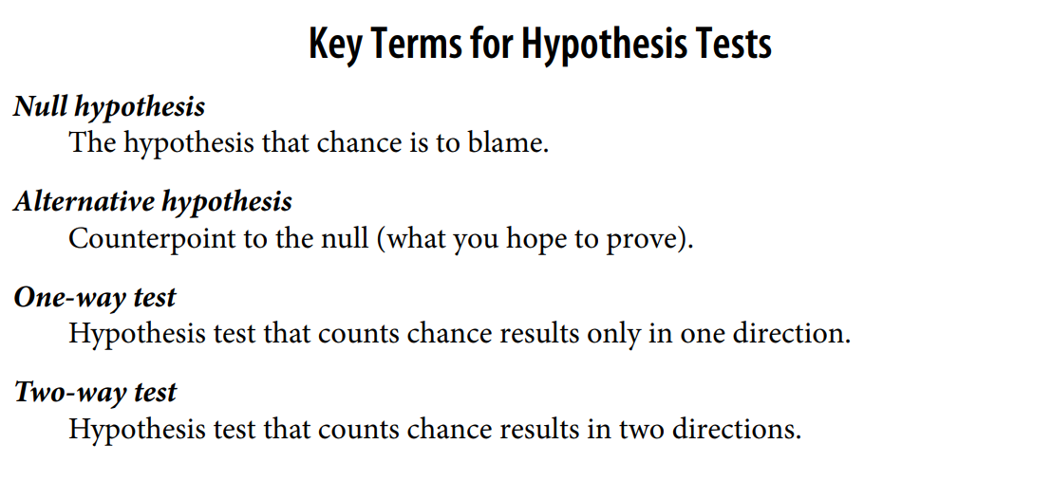
Hypothesis Tests

Slide 18
Hypothesis Tests
Level of confidence: How sure we are in our decision.
  Variable is C, say 95% or 99%
Level of Significance
  Variable is α (alpha)
  α = 1 - C
  So if C = 95%, or C = 0.95
  α = 1 - 0.95 = 0.05
Both terms specify the same thing.
Some problems use Level of confidence and other uses Level of Significance
The goal is to determine, How sure are you that, making a right decision or not.

Slide 19
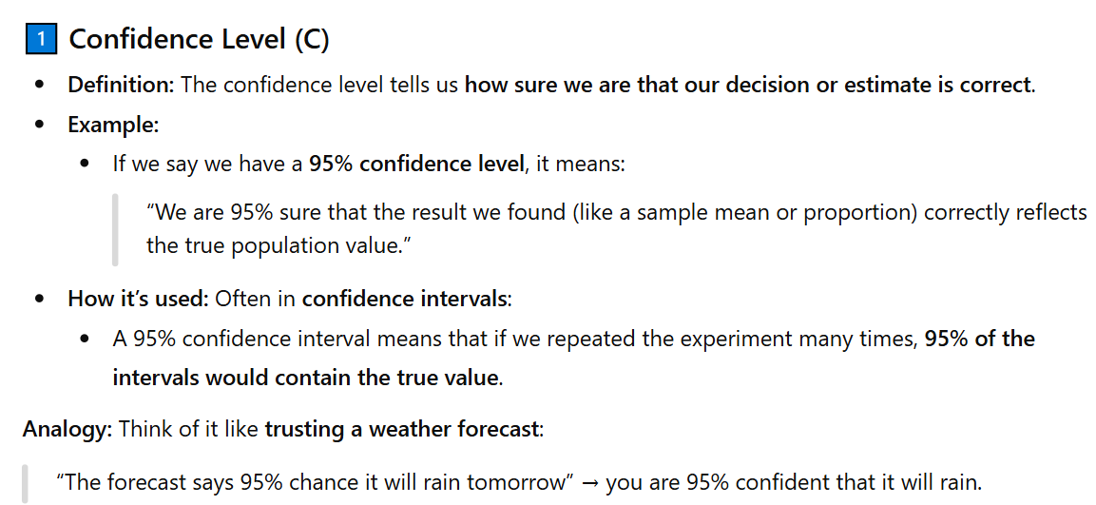
Hypothesis Tests

Slide 20
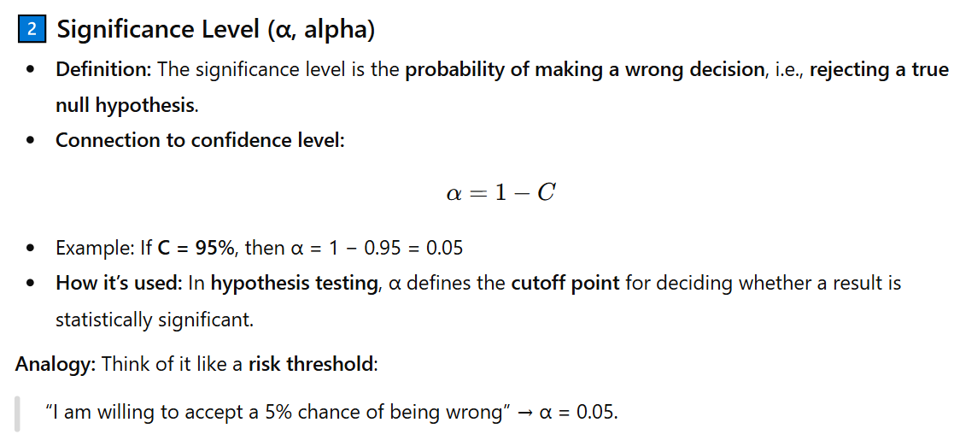
Hypothesis Tests

Slide 21
Hypothesis Testing
Concept | Meaning
Confidence Level (C) | How confident you are that your decision is correct
Significance Level (α) | The chance you’re wrong when making the decision
Relationship | α = 1 − C
Both are just two sides of the same coin — one expresses certainty, the other expresses risk.

Slide 22
Resampling
Resampling in statistics means to repeatedly sample values from observed data, with a general goal of assessing random variability in a statistic.
There are two main types of resampling procedures:
  the bootstrap and permutation tests.
In bootstrap (already discussed)
  we selected data samples with replacement,
  compute any metric of each sample like accuracy of ML model and
  take average results with standard deviation like 82±3%.

Slide 23
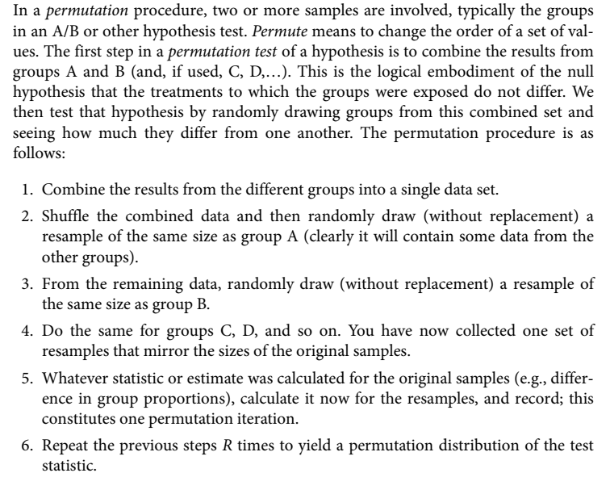
Resampling: Permutation Test

Slide 24
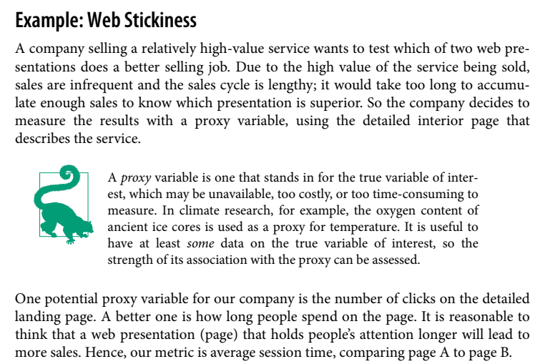
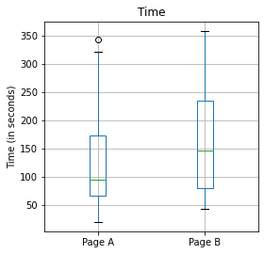
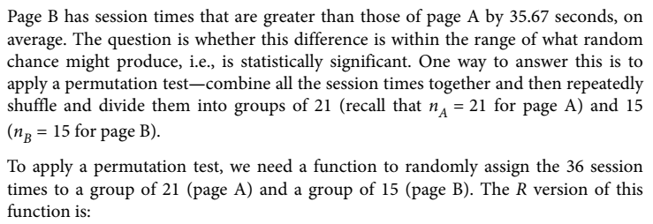
Resampling: See Python code

Slide 25
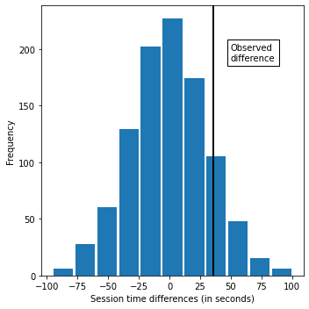
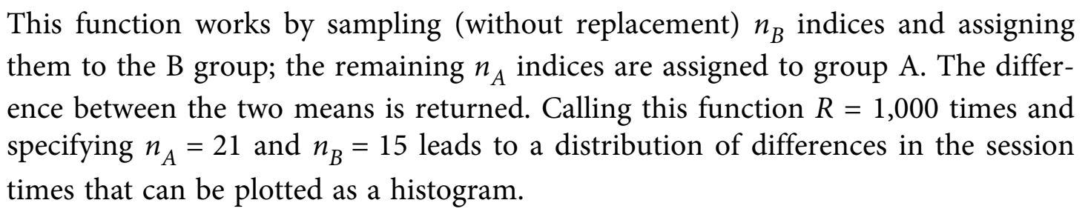
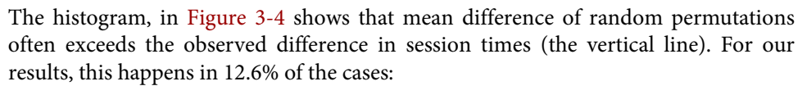
Resampling: Permutation Test

Slide 26
Resampling
Resampling in statistics means to repeatedly sample values from observed data, with a general goal of assessing random variability in a statistic.
There are two main types of resampling procedures:
  the bootstrap and permutation tests.
In bootstrap (already discussed)
  we selected data samples with replacement,
  compute any metric of each sample like accuracy of ML model and
  take average results with standard deviation like 82±3%.

Slide 27
Resampling
See Google colab notebook for python code and more explanation

Slide 28
Resampling: Permutation Test
Example: Take multiple groups each one of 7 patients from A to G and collect the data for experimental and control group.

Slide 29
Statistical Significance and p-Values
Simply looking at the graph is not a very precise way to measure statistical significance, so of more interest is the p-value.
This is the frequency with which the chance model produces a result more extreme than the observed result.
P-value is the probability for the NULL hypothesis to be true.
    E.g., if p value is 0.05 then if observed difference fall in that area will make NULL true
    If p value if less than alpha (0.05 or 0.01) then NULL hypothesis is rejected
A p-value, or probability value, is a number describing how likely it is that your data would have occurred by random chance (i.e., that the null hypothesis is true).
We can estimate a p-value from our permutation test by taking the proportion of times that the permutation test produces a difference >= (equal to or greater) than the observed difference:
The smaller the p-value, the less likely the results occurred by random chance, and the stronger the evidence that you should reject the null hypothesis.
In colab notebook example the p-value is 0.308, which means that we would expect to achieve a result as extreme as this, or a more extreme result, by random chance over 30% of the time.

Slide 30
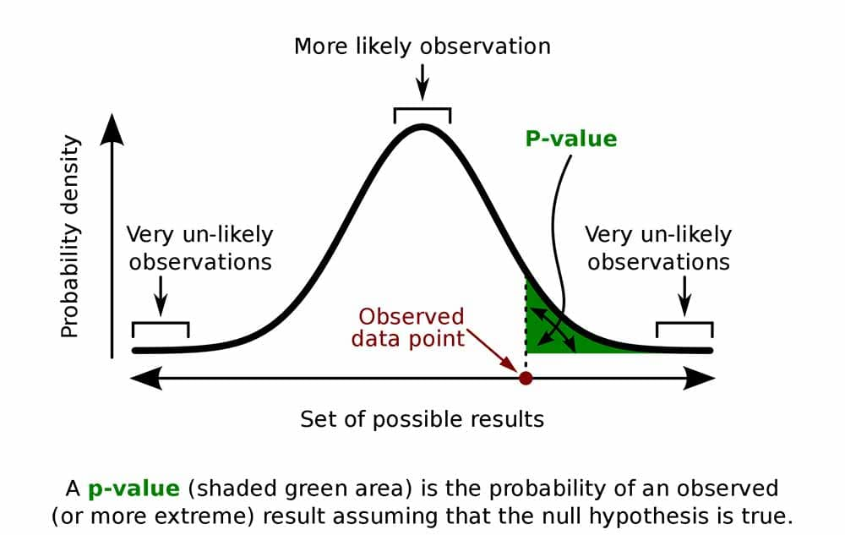
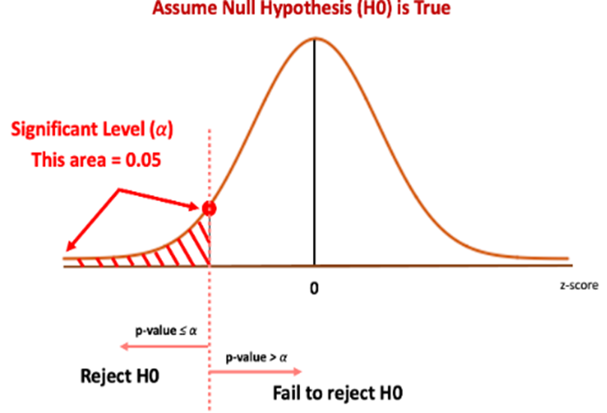
Statistical Significance and p-Values
When you perform a statistical test, a p-value helps you determine the significance of your results in relation to the null hypothesis.
The null hypothesis (H0) states no relationship exists between the two variables being studied (one variable does not affect the other). It states the results are due to chance and are not significant in supporting the idea being investigated. Thus, the null hypothesis assumes that whatever you try to prove did not happen.

Slide 31
Resampling: Permutation Test
Example (see colab notebook example):
  Suppose we got the proportion of 8.3% but it is not as low as our standard threshold like 5% (null hypothesis)
  Thus we conclude that there is no significant difference between control and experimental group.
  Fail to reject the null hypothesis.

Slide 32
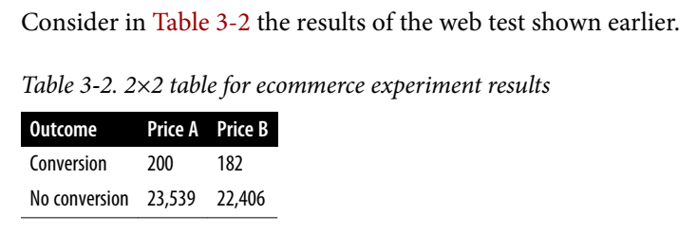
Statistical Significance and p-Values
Statistical significance is how statisticians measure whether an experiment (or even a study of existing data) yields a result more extreme than what chance might produce.
If the result is beyond the realm/area/range of chance variation, it is said to be statistically significant.
Price A converts almost 5% better than price B
0.8425% = 200/(23539+200)*100, versus
0.8057% = 182/(22406+182)*100
a difference of 0.0368 percentage points), big enough to be meaningful in a high-volume business.

Slide 33
Statistical Significance and p-Values
We can test whether the difference in conversions between prices A and B is within the range of chance variation, using a resampling procedure.
  By chance variation, we mean the random variation produced by a probability model that embodies the
    null hypothesis that there is no difference between the rates.

Slide 34
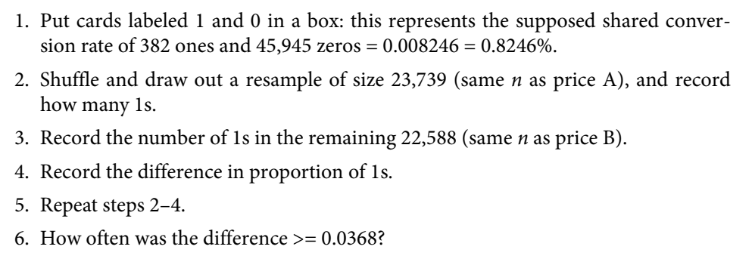
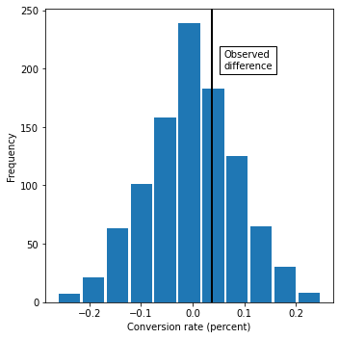
Statistical Significance and p-Values
The following permutation procedure asks,
  “If the two prices share the same conversion rate, could chance variation produce a difference as big as 5%?

Slide 35
p-Values and Data Science
A p-value is a useful metric in situations where you want to know whether a model results that appears interesting and useful is within the range of normal chance variability
As a decision tool in an experiment, a p-value should not be considered controlling, but merely another point of information bearing on a decision
For example, p-values are sometimes used as intermediate inputs in some statistical or machine learning models—a feature might be included in or excluded from a model depending on its p-value

Slide 36
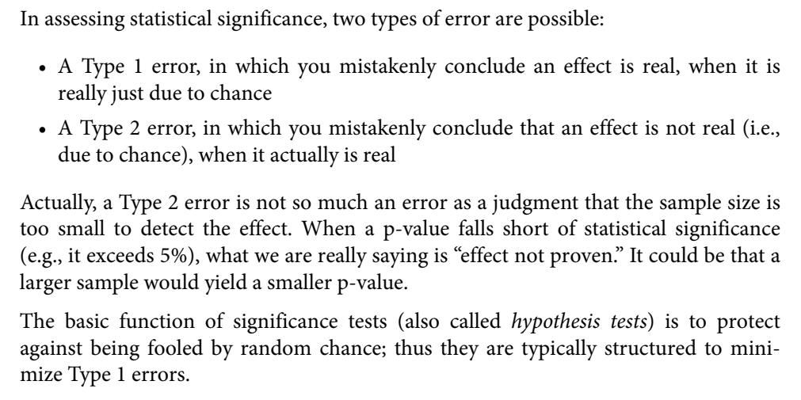
Type 1 and Type 2 Errors

Slide 37
t-Tests/ Student’s t-test
Student’s t-test, in statistics, a method of testing hypotheses about the mean of a small sample drawn from a normally distributed population when the population standard deviation is unknown.
The t distribution is a family of curves in which the number of degrees of freedom (the number of independent observations in the sample minus one) specifies a particular curve.
As the sample size (and thus the degrees of freedom) increases, the t distribution approaches the bell shape of the standard normal distribution.
In practice, for tests involving the mean of a sample of size greater than 30, the normal distribution is usually applied.

Slide 38
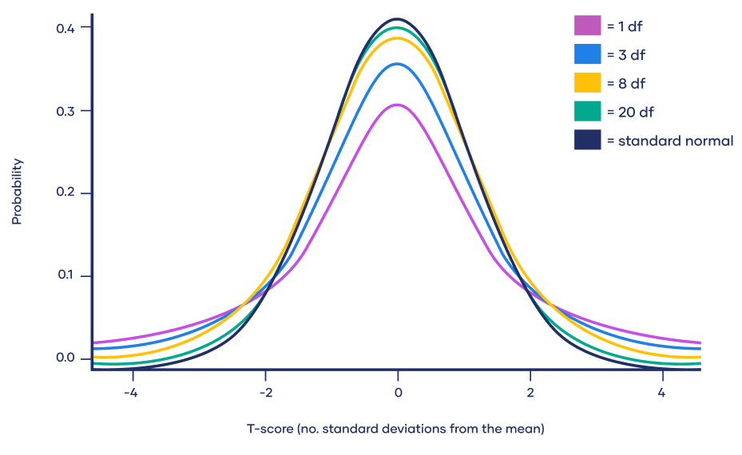
t-Tests/ Student’s t-test

Slide 39
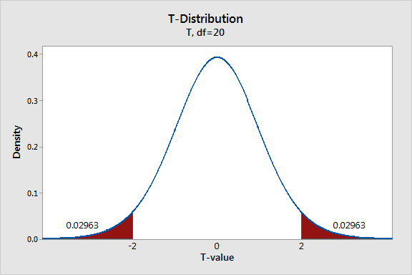
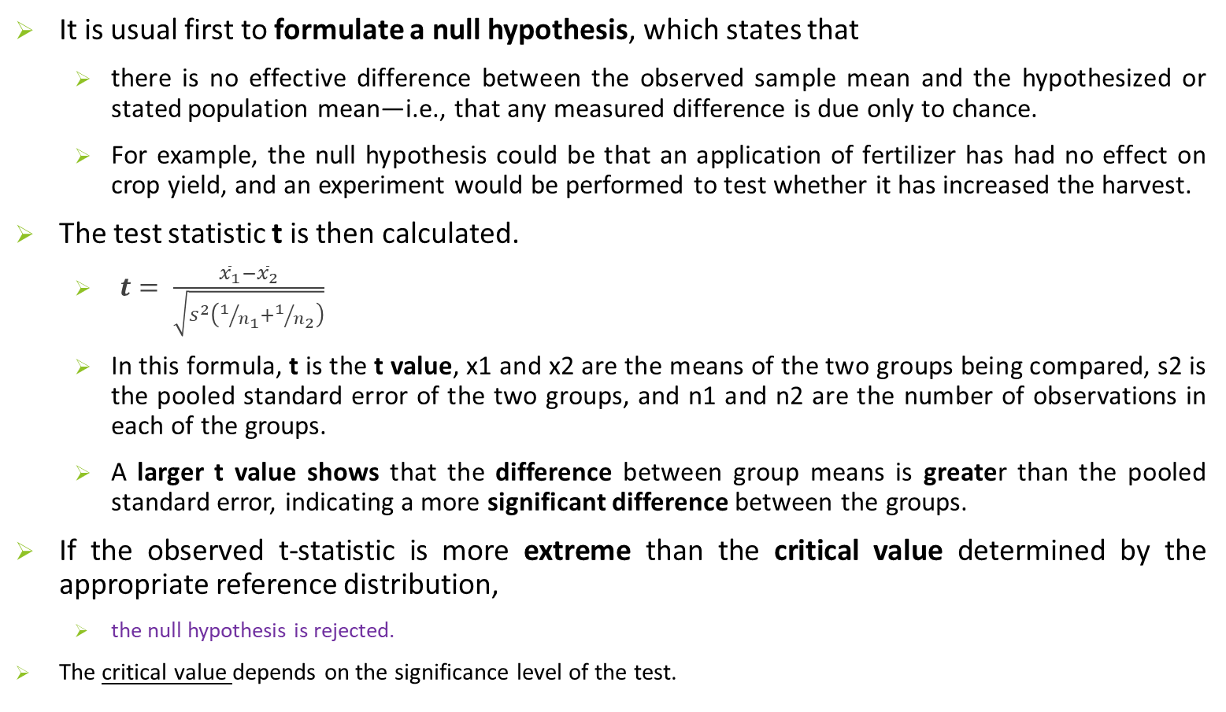
t-Tests
It is usual first to formulate a null hypothesis, which states that
  there is no effective difference between the observed sample mean and the hypothesized or stated population mean—i.e., that any measured difference is due only to chance.
  For example, the null hypothesis could be that an application of fertilizer has had no effect on crop yield, and an experiment would be performed to test whether it has increased the harvest.
The test statistic t is then calculated.
  $t= \frac{{\overline{x}}_{1}−{\overline{x}}_{2}}{\sqrt{s^{2}\left(1/{n_{1}}+1/{n_{2}}\right)}}$
  In this formula, t is the t value, x1 and x2 are the means of the two groups being compared, s2 is the pooled standard error of the two groups, and n1 and n2 are the number of observations in each of the groups.
  A larger t value shows that the difference between group means is greater than the pooled standard error, indicating a more significant difference between the groups.
If the observed t-statistic is more extreme than the critical value determined by the appropriate reference distribution,
  the null hypothesis is rejected.
The critical value depends on the significance level of the test.

Slide 40
t-Tests
The t test is a *parametric test of difference, meaning that it makes the same assumptions about your data as other parametric tests. The t test assumes your data:
  are independent
  are (approximately) normally distributed
  have a similar amount of variance within each group being compared (a.k.a. homogeneity of variance)
*Parametric tests are those that make assumptions about the parameters of the population distribution from which the sample is drawn

Slide 41
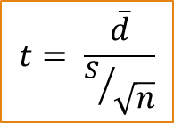

What type of t test should I use?
One-sample, two-sample, or paired t test?
  If the groups come from a single population (e.g., measuring before and after an experimental treatment), perform a paired t test.
  If the groups come from two different populations (e.g., two different species, or people from two separate cities), perform a two-sample t test (a.k.a. independent t test). This is a between-subjects design.
  If there is one group being compared against a standard value (e.g., comparing the acidity of a liquid to a neutral pH of 7), perform a one-sample t test.
One-tailed or two-tailed t test?
  If you only care whether the two populations are different from one another, perform a two-tailed t test.
  If you want to know whether one population mean is greater than or less than the other, perform a one-tailed t test.
$$t= \frac{\overline{x}−μ}{s/{\sqrt{n}}}$$

Slide 42
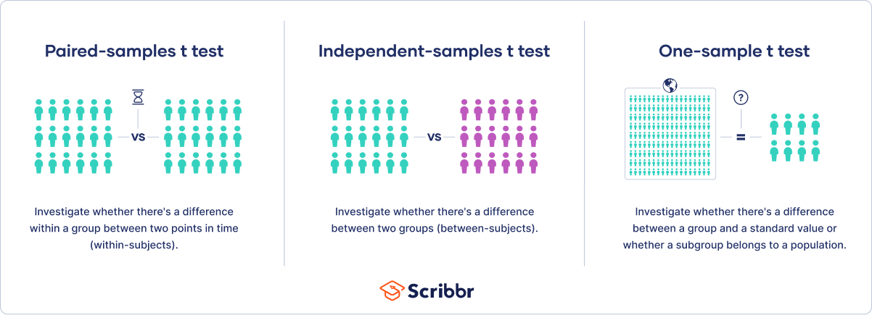
What type of t test should I use?

Slide 43
Why t test (Additional reading)
All significance tests require that you specify a test statistic to measure the effect you are interested in and help you determine whether that observed effect lies within the range of normal chance variation. In a resampling test (see the discussion of permutation in “Permutation Test”), the scale of the data does not matter. You create the reference (null hypothesis) distribution from the data itself and use the test statistic as is.
In the 1920s and 1930s, when statistical hypothesis testing was being developed, it was not feasible to randomly shuffle data thousands of times to do a resampling test. Statisticians found that a good approximation to the permutation (shuffled) distribution was the t-test, based on Gosset’s t-distribution.

Slide 44
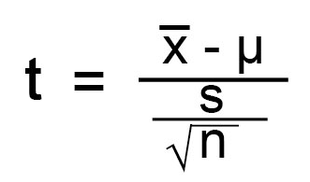
t-Tests(One-sample)
For example, suppose a researcher wishes to test the hypothesis that a sample of size n = 25 with mean x = 79 and standard deviation s = 10 was drawn at random from a population with mean μ = 75 and unknown standard deviation.
Using the formula for the t-statistic:
the calculated t equals 2.
For a two-sided test at a common level of significance α = 0.05,
the critical values from the t distribution on (df=n-1=25-1) 24 degrees of freedom are −2.064 and 2.064.
The calculated t (t=2) does not exceed these values,
hence the null hypothesis cannot be rejected(fail to reject) with 95 percent confidence. (The confidence level is 1 − α = 1-0.05 = 0.95 = 95%.)

Slide 45
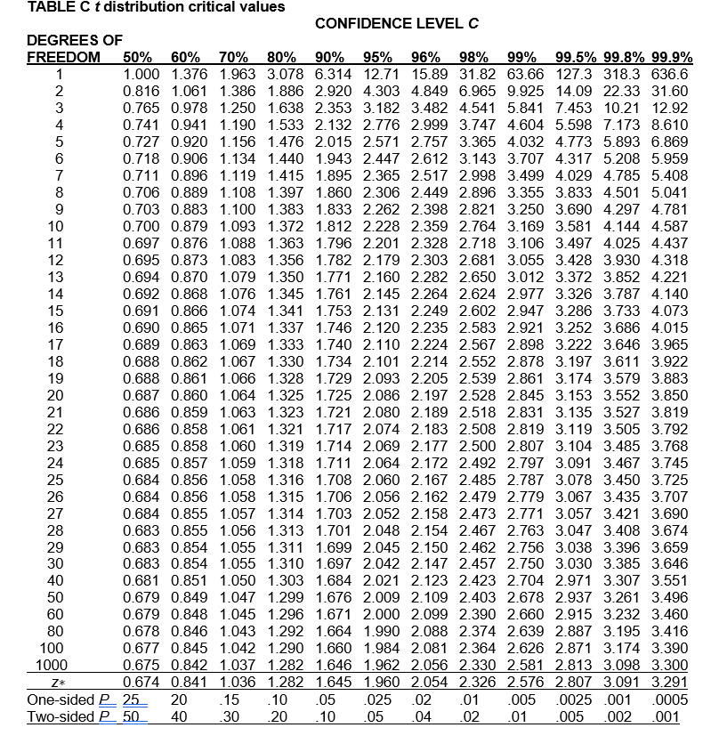
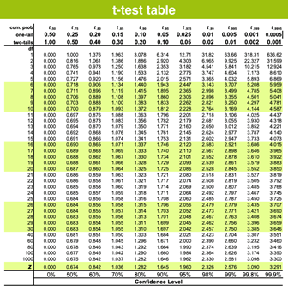
t-Tests

Slide 46

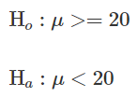
t-Tests (One-tailed vs. two-tailed tests)
When you define the hypothesis, you also define whether you have a one-tailed or a two-tailed test. You should make this decision before collecting your data or doing any calculations
To explain, let’s use the one-sample t-test. Suppose we have a random sample of protein bars, and the label for the bars advertises 20 grams of protein per bar. The null hypothesis is that the unknown population mean is 20. Suppose we simply want to know if the data shows we have a different population mean. In this situation, our hypotheses are:
Here, we have a two-tailed test. We will use the data to see if the sample average differs sufficiently from 20 – either higher or lower – to conclude that the unknown population mean is different from 20.
Suppose instead that we want to know whether the advertising on the label is correct. Does the data support the idea that the unknown population mean is at least 20? Or not? In this situation, our hypotheses are:
Here, we have a one-tailed test. We will use the data to see if the sample average is sufficiently less than 20 to reject the hypothesis that the unknown population mean is 20 or higher.

Slide 47
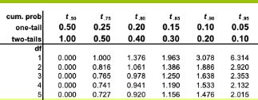
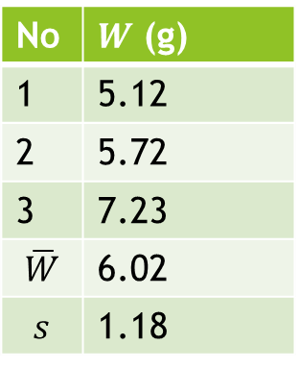
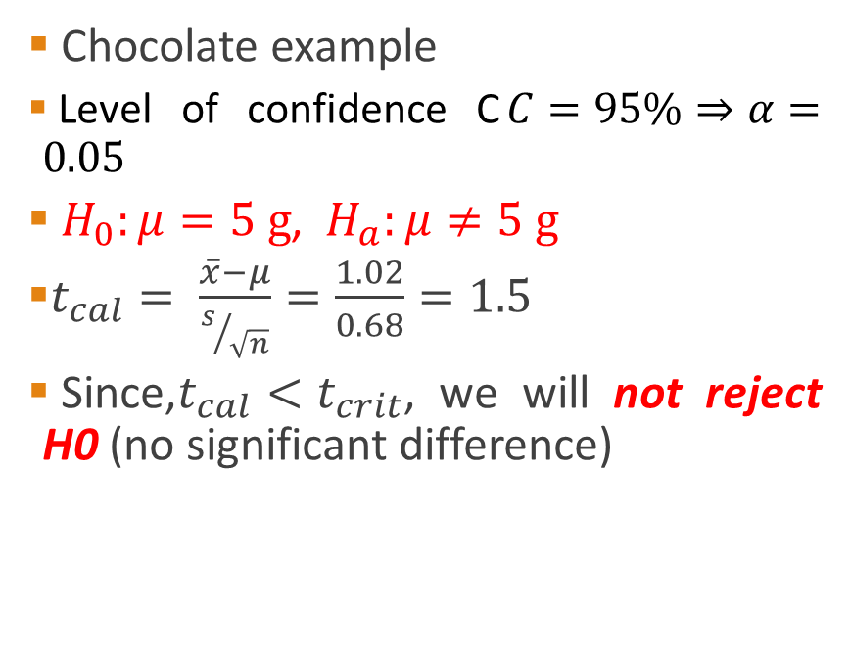
t-Tests (One-tailed vs. two-tailed tests)
Chocolate example
Level of confidence C$C=95\%⇒α=0.05$
$H_{0}:μ=5 g$, $H_{a}:μ≠5 g$
$t_{cal}= \frac{\overline{x}−μ}{s/{\sqrt{n}}}=\frac{1.02}{0.68}=1.5$
Since,$t_{cal}<t_{crit}$, we will not reject H0 (no significant difference)
No | $W$ (g)
1 | 5.12
2 | 5.72
3 | 7.23
$$\overline{W}$$ | 6.02
$$s$$ | 1.18

Slide 48
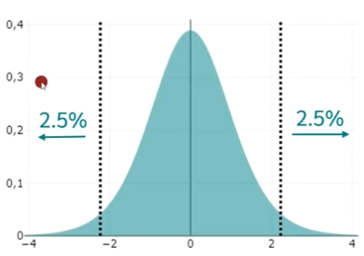

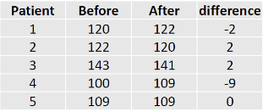
t-Tests (example)
A medical trail of a BP medicine was performed on five volunteers and their respective BPs are shown in the table. Is there a difference between before and after the treatment at 95% CI?

Slide 49

t-Tests (example)
$H_{0}:μ_{b}=μ_{a}$
$H_{a}:μ_{b}≠μ_{a}$
$\overline{d}=\frac{−2+2+2−9+0}{5}=−1.4$
$s=\sqrt{\frac{{\left(−2+1.4\right)}^{2}+{\left(2+1.4\right)}^{2}+{\left(2+1.4\right)}^{2}+{\left(−9+1.4\right)}^{2}+{\left(0+1.4\right)}^{2}}{5−1}}=4.56$
$s/{\sqrt{n}}=\frac{4.56}{2.236}\sim 2.04$
$t_{cal}=\frac{−1.4}{2.04}=0.69$
$t_{crit}=2.776$ (from table)
Since,$t_{cal}<t_{crit}$, we will not reject H0 (no significant impact of the medicine)

Slide 50

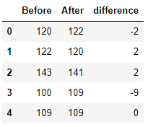
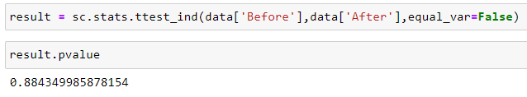
t-Tests (example)

Slide 51
ANOVA
The t-test is a method that determines whether two populations are statistically different from each other, whereas ANOVA determines whether three or more populations are statistically different from each other.
The statistical procedure that tests for a statistically significant difference among the groups is called analysis of variance, or ANOVA

Slide 52
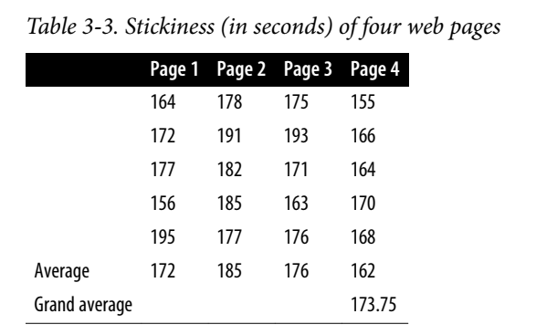
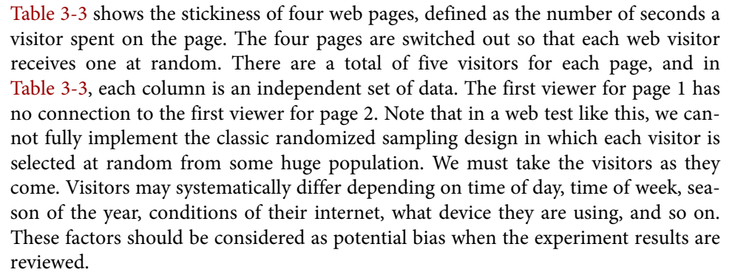
ANOVA
Suppose that, instead of an A/B test, we had a comparison of multiple groups, say A/B/C/D, each with numeric data.
The statistical procedure that tests for a statistically significant difference among the groups is called analysis of variance, or ANOVA.

Slide 53
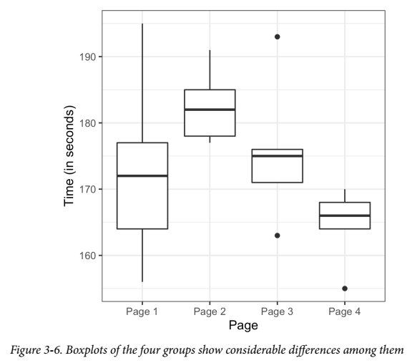
ANOVA
Now we have a conundrum (see Figure 3-6). When we were comparing just two groups, it was a simple matter; we merely looked at the difference between the means of each group.
With four means, there are six possible comparisons between groups:
  Page 1 compared to page 2
  Page 1 compared to page 3
  Page 1 compared to page 4
  Page 2 compared to page 3
  Page 2 compared to page 4
  Page 3 compared to page 4
The more such pairwise comparisons we make, the greater the potential for being fooled by random chance

Slide 54
ANOVA
Instead of worrying about all the different comparisons between individual pages we could possibly make, we can do a single overall test that addresses the question,
“Could all the pages have the same underlying stickiness, and the differences among them be due to the random way in which a common set of session times got allocated among the four pages?”

Slide 55
ANOVA
The procedure used to test this is ANOVA. The basis for it can be seen in the following resampling procedure (specified here for the A/B/C/D test of web page stickiness):
  Combine all the data together in a single box.
  Shuffle and draw out four resamples of five values each.
  Record the mean of each of the four groups.
  Record the variance among the four group means.
  Repeat steps 2–4 many (say, 1,000) times.
What proportion of the time did the resampled variance exceed the observed variance? This is the p-value.
The resultant p-value is 0.092. In other words, given the same underlying stickiness, 9.3% of the time the response rate among four pages might differ as much as was actually observed, just by chance. This degree of improbability falls short of the traditional statistical threshold of 5%, so we conclude that the difference among the four pages could have arisen by chance.

Slide 56
Two Way ANOVA
A one-way ANOVA uses one independent variable, while a two-way ANOVA uses two independent variables.
You can use a two-way ANOVA when you have collected data on a quantitative dependent variable at multiple levels of two categorical independent variables.
A quantitative variable represents amounts or counts of things. It can be divided to find a group mean.

Slide 57
Chi-Square Test
Web testing often goes beyond A/B testing and tests multiple treatments at once.
The chi-square test is used with count data to test how well it fits some expected distribution.
The most common use of the chi-square statistic in statistical practice is with r × c contingency tables, to assess whether the null hypothesis of independence among variables is reasonable.
Chi-Square Test: A Resampling Approach
  Suppose you are testing three different headlines A, B, and C and you run them each on 1,000 visitors, with the results shown in Table 3-4 (PTO).

Slide 58
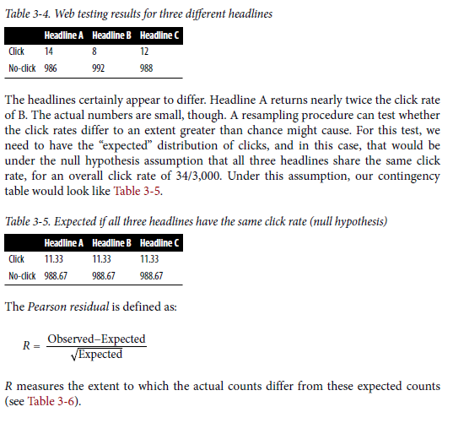
Chi-Square Test

Slide 59
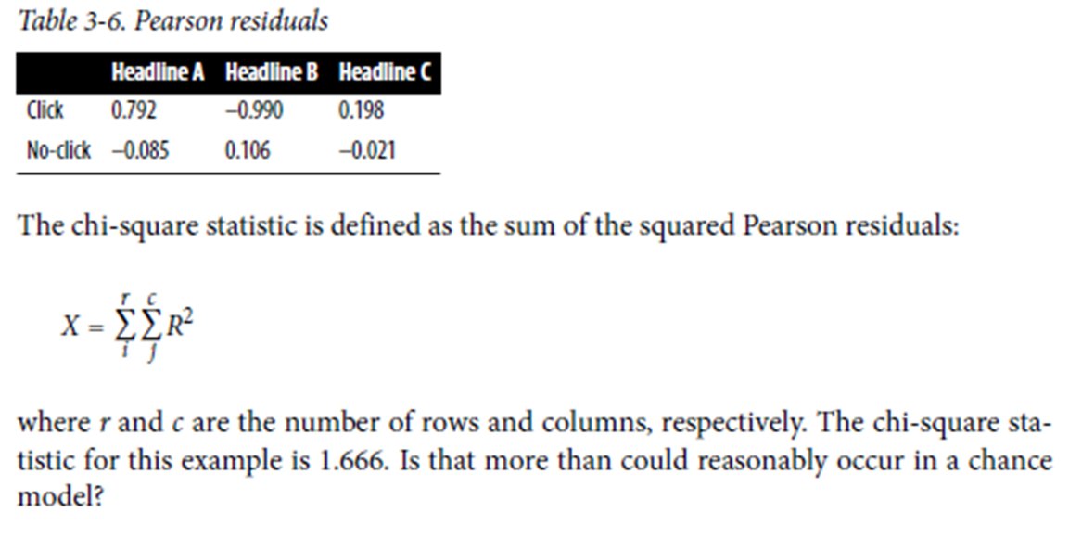
Chi-Square Test

Slide 60
Chi-Square Test
We can test with this resampling algorithm:
  Constitute a box with 34 ones (clicks) and 2,966 zeros (no clicks).
  Shuffle, take three separate samples of 1,000, and count the clicks in each.
  Find the squared differences between the shuffled counts and the expected counts and sum them.
  Repeat steps 2 and 3, say, 1,000 times.
  How often does the
After resampling 1000 times we got chi square value of 1.6659 and concerned p-value is 0.4853 that show this result could have been obtained easily by a random chance.

